Slide 1
New York rental listings
How much interest will a new rental listing receive?

Slide 2
For this project the publicly available data for the” Two Sigma Connect: Rental Listing Inquiries” Kaggle competition will be considered. The hypothesis of this project is that we can use the foursquare api for exploring a location for improving the model. In order to do so, we have to specify an url and pass the coordinates of the relevant data point and make a request. The resulting json response can be extracted and put into a new pandas data frame. The new created features are: categories: number of unique foursquare venue categories distance: mean distance of foursquare venues

Slide 3

Methodology

Slide 4
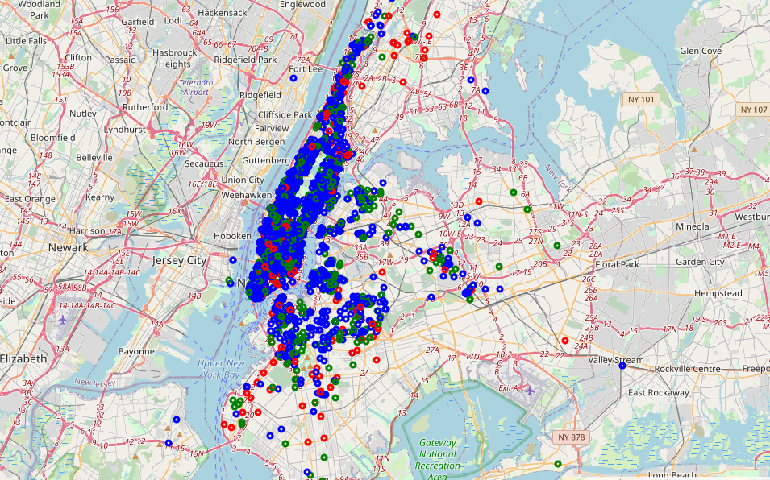
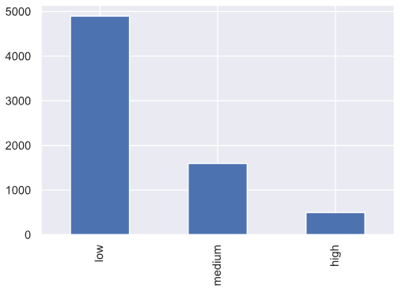
Exploratory Data Analysis (EDA)
Target Variable:
Interest level

Slide 5
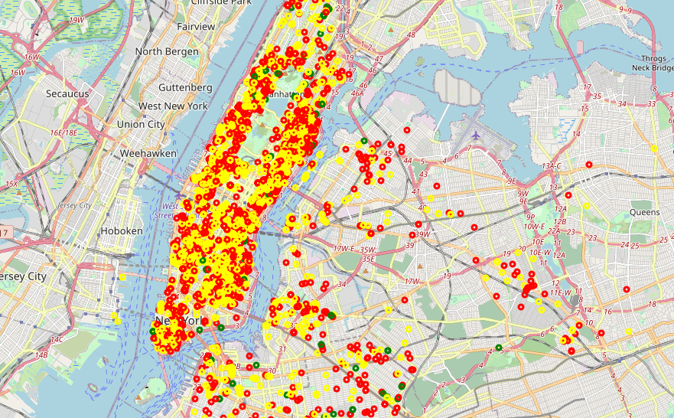
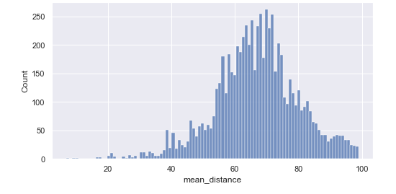
Exploratory Data Analysis (EDA)
mean distance
Mean distance of foursquare venues
green points represent a low value, yellow a medium value and red a high value.

Slide 6
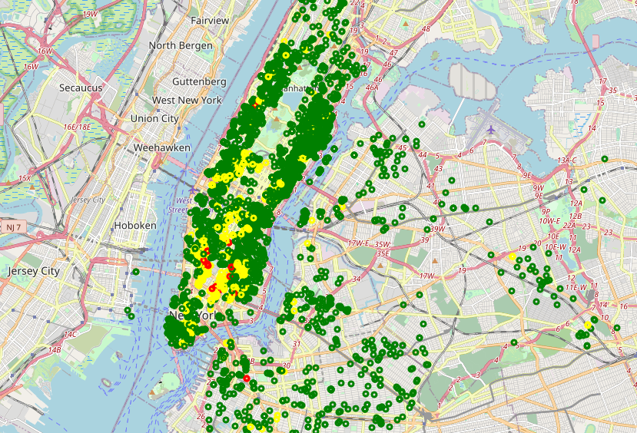
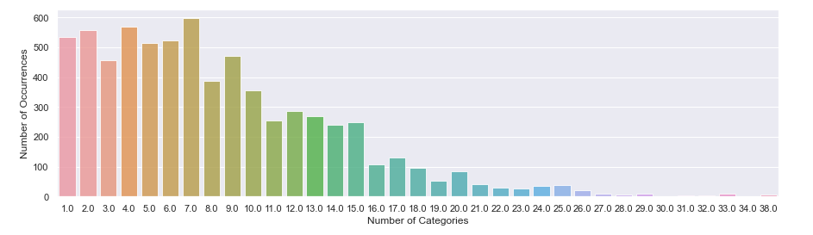
Exploratory Data Analysis (EDA)
categories
Number of unique foursquare venue categories
green points represent a low value, yellow a medium value and red a high value.

Slide 7
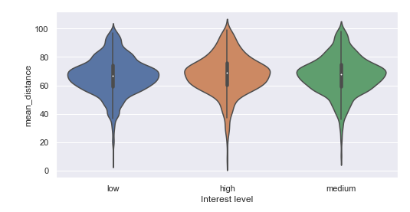
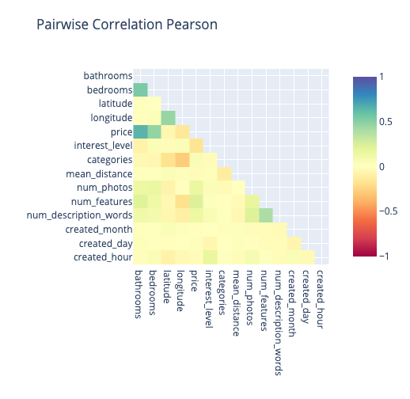
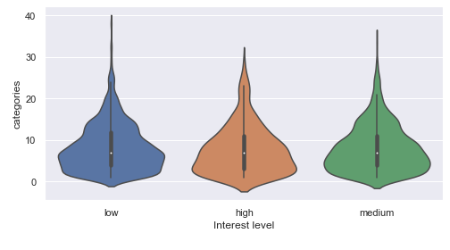
Exploratory Data Analysis (EDA)
Correlation with target

Slide 8
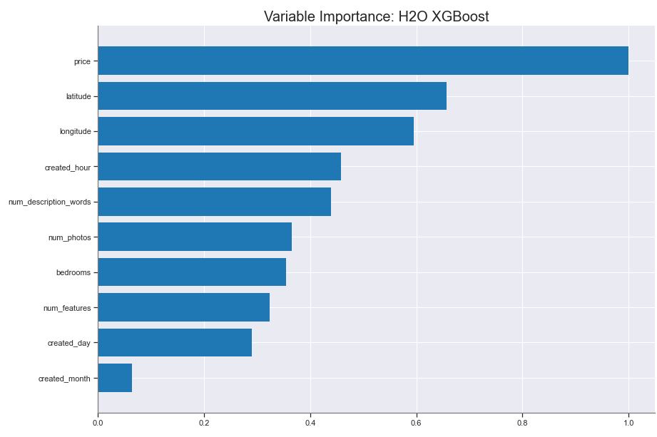
Results
Baseline Model
ModelMetricsMultinomial: xgboost
** Reported on train data. **
MSE: 0.09305668048815223
RMSE: 0.30505193080548143
LogLoss: 0.3075453925310763
Mean Per-Class Error: 0.1623435251635366
** Reported on validation data. **
MSE: 0.21445060605228666
RMSE: 0.4630881191007675
LogLoss: 0.6351238727480131
Mean Per-Class Error: 0.5622636243951696

Slide 9
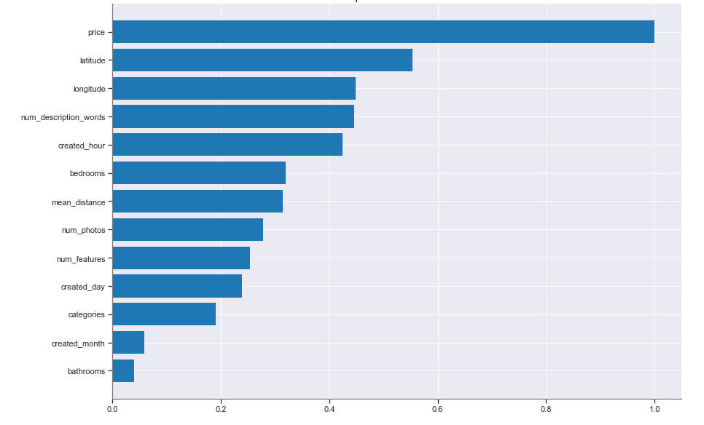
Results
Extended model
ModelMetricsMultinomial: xgboost
** Reported on train data. **
MSE: 0.08892165485306923
RMSE: 0.29819734212945165
LogLoss: 0.2978544109530065
Mean Per-Class Error: 0.14100806913270514
** Reported on validation data. **
MSE: 0.21528158906693382
RMSE: 0.46398447071743015
LogLoss: 0.6564431960940968
Mean Per-Class Error: 0.555266238294481

Slide 10
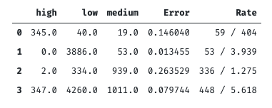
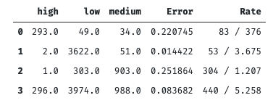
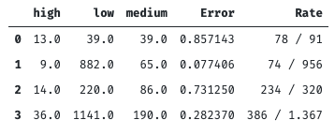
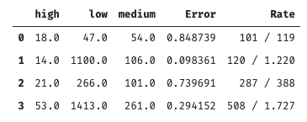
Results
Confusion Matrices
Extended Baseline
Train
Validation

Slide 11
Conclusion
Two features have been proposed
Baseline and Extended model have been built
Importance for the model to predict the interest level of a customer was not significant
Hypothesis was rejected
Future work should include a larger dataset with more api calls

